Slide 1
Real-Time Shadows Demo
Graphics and Computational Programming
Yashwanth Kumar Vishwanath Siddappa
S5068802 10/01/2020

Slide 2
TOC
Shadows in the real world
Different techniques to implement shadows
Chosen technique for this project
Shadow Demo Results
Evaluation

Slide 3

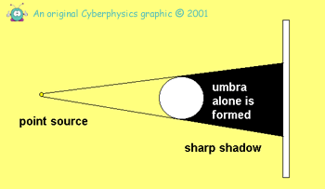
Understanding Shadows in the real world
Formed when opaque objects block light preventing the light to pass it.
Creates a dark silhouette of the object.
The area which the light cannot directly reach is called the “umbra”.

Slide 4
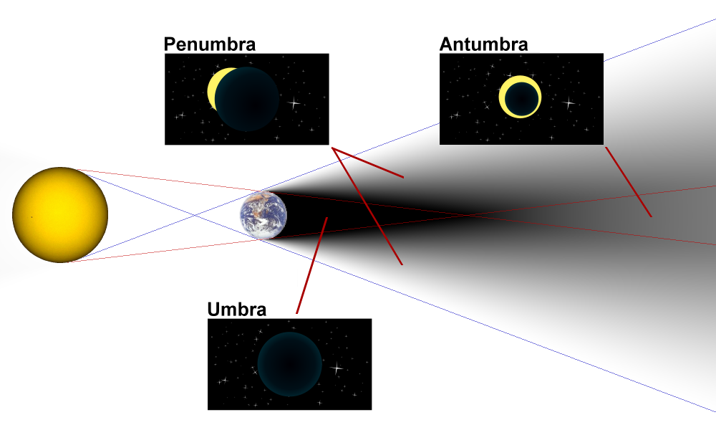
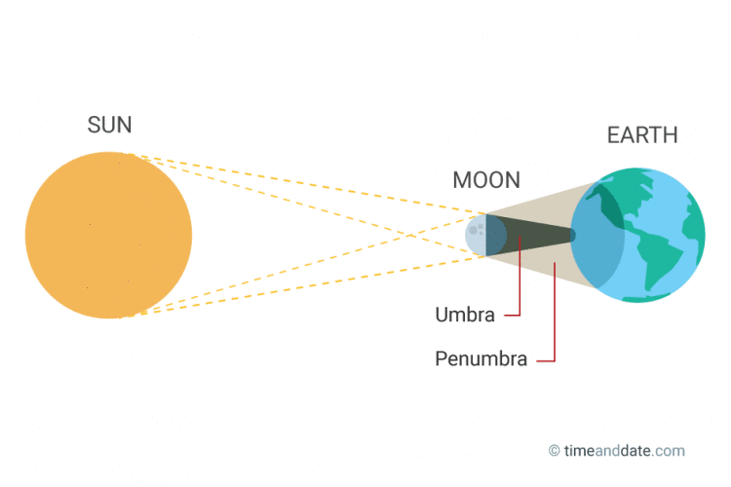
Penumbra and Antumbra

Slide 5
Different types of shadow implementations
01
Shadow Mapping
02
Ray Tracing
03
Geometry

Slide 6
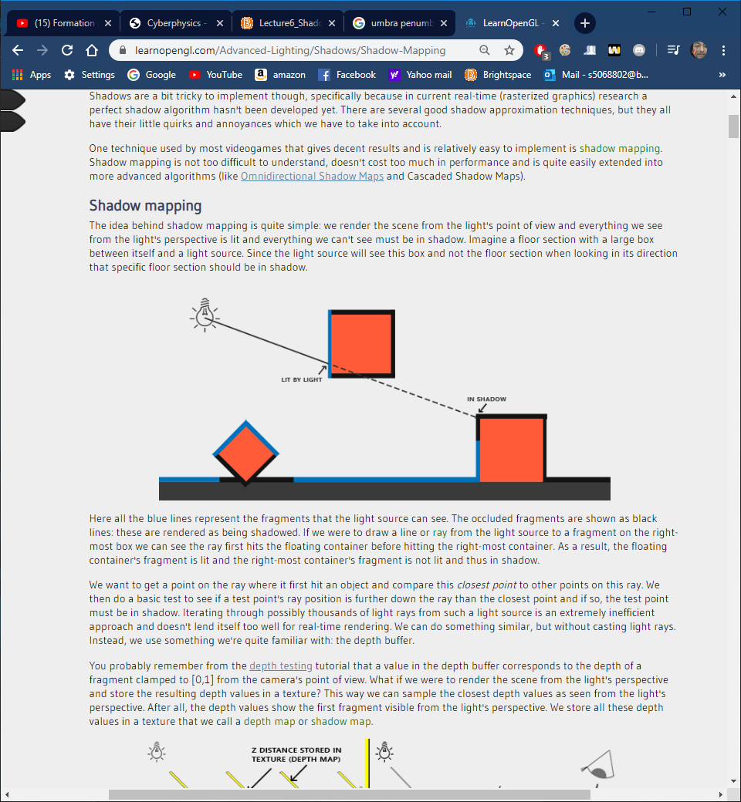
Different types of shadow implementations
1a - Basic Shadow Mapping
Simplest method
Render from lights point of view storing the depth into a depth texture.
Use texture to apply shadows on objects.

Slide 7
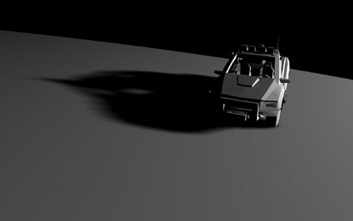
Different types of shadow implementations
1b - Variance Shadow Mapping
Soft shadow
Computes variance for filter size

Slide 8
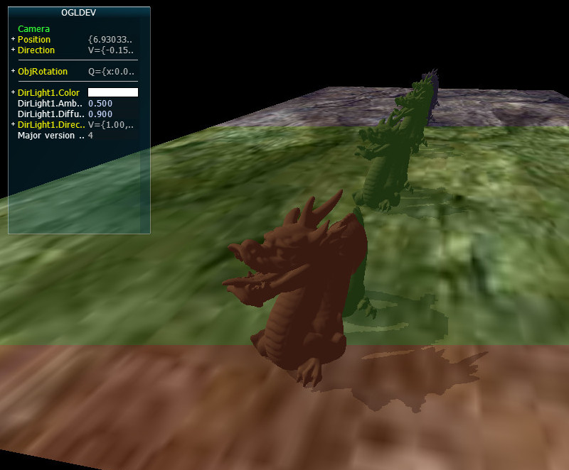
Different types of shadow implementations
1c - Cascaded Shadow Mapping
Multiple shadow maps
Good for large scenes

Slide 9
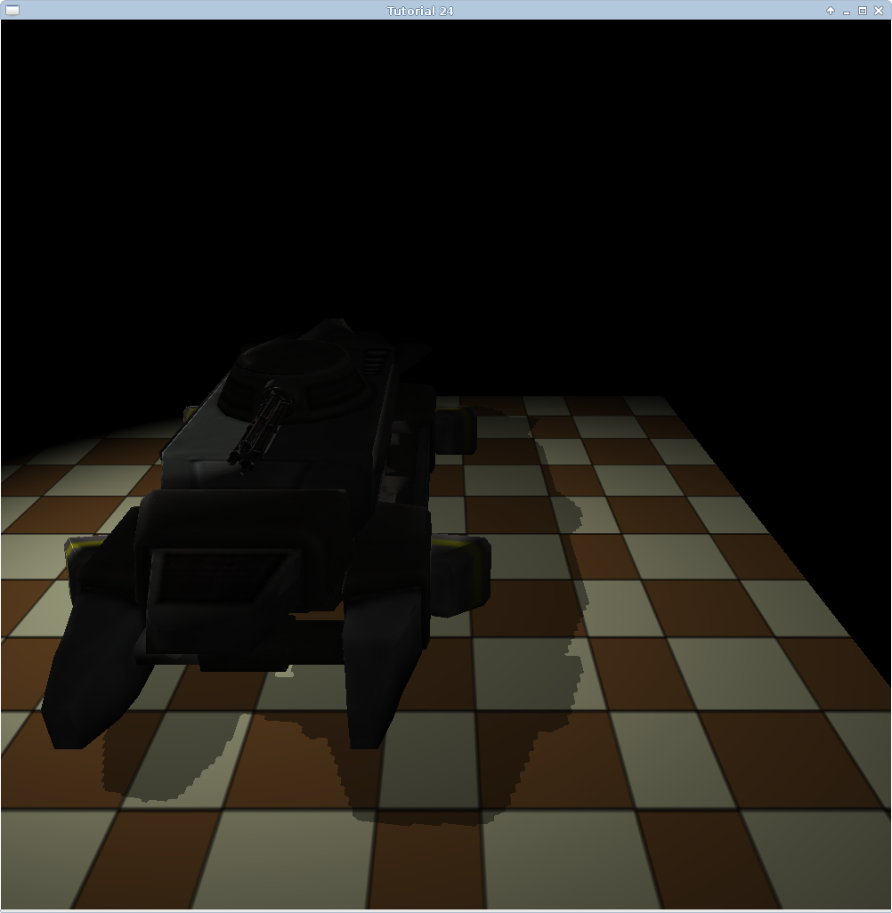
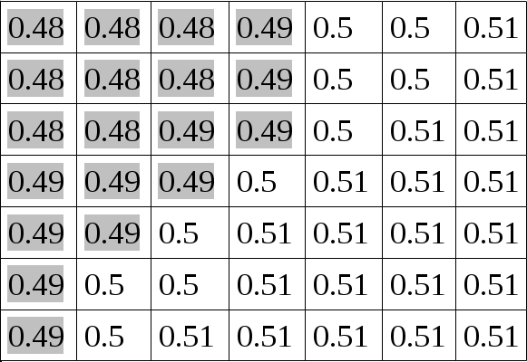
Different types of shadow implementations
1d - Percentage Closer Filtering
Soft shadow
Remove aliasing
Compares depth of sample from a depth map to samples around it to get smoother shadow line.

Slide 10
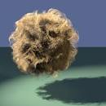
Different types of shadow implementations
1e - Deep Shadows
High quality shadows for primitives

Slide 11
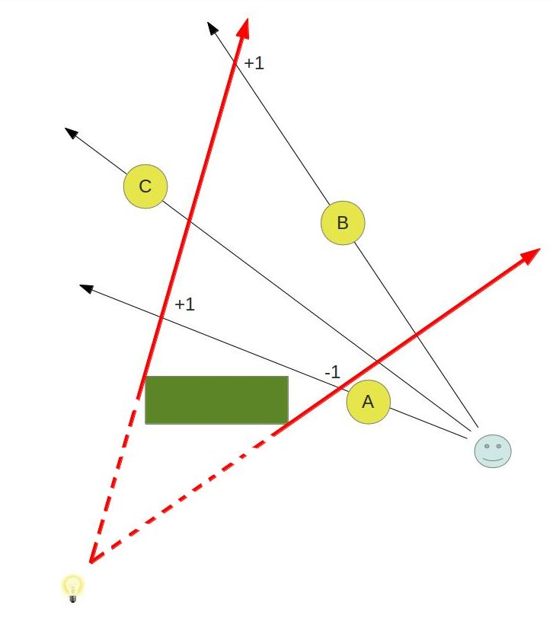
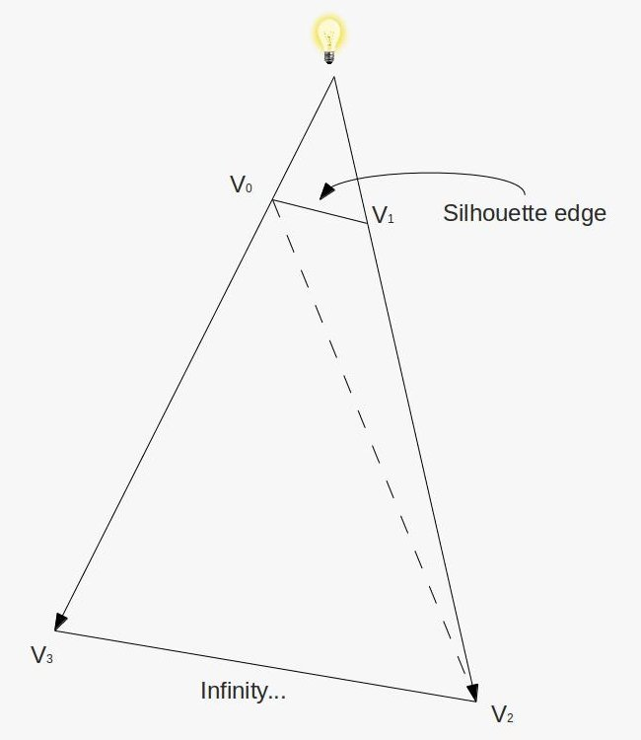
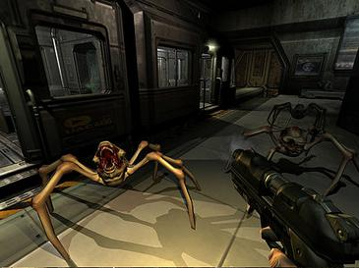
Different types of shadow implementations
2 - Geometry
Extend an object’s volume to find out if the object are inside it and therefore in the shadow.

Slide 12
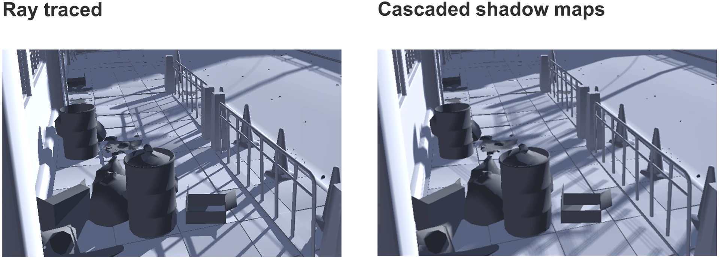
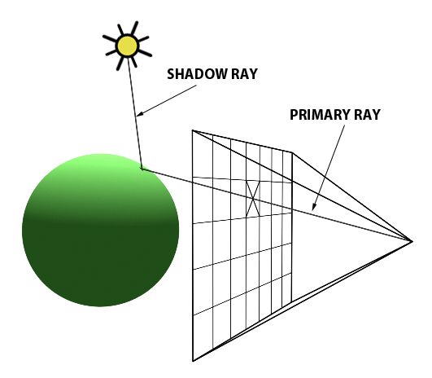
Different types of shadow implementations
3 - Raytracer and Ray Marching
Creates rays from a point to light source.
If the ray is obscured, then the object in the shadow.

Slide 13
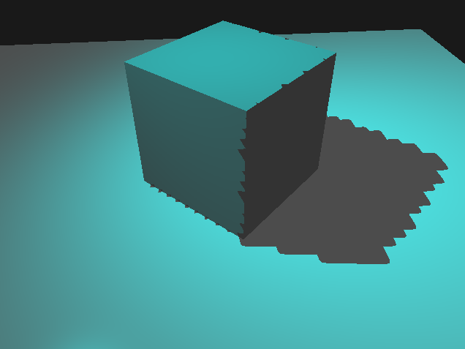
Chosen technique = Shadow Mapping!
Develop OpenGL skills
Variety of soft shadows
 | Shadow Mapping | Raymarching | Geometry Stencil Volume
Pros | Easy and lots of techniques to improve on top of it. | Good results. | Animations and multiple light sources look great
Cons | Not the best looking out of the three. | Can be computationally more expensive. | Soft shadows difficult to implement

Slide 14
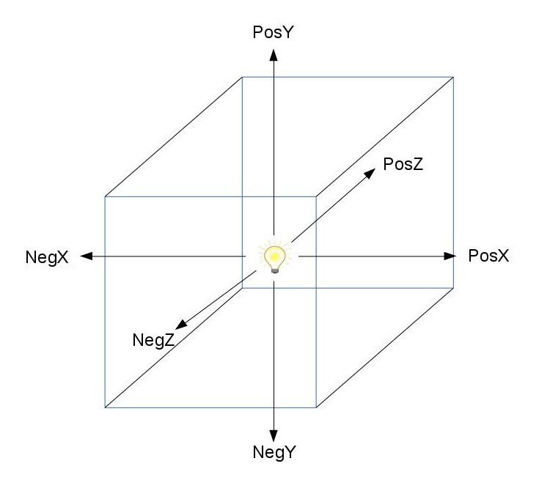
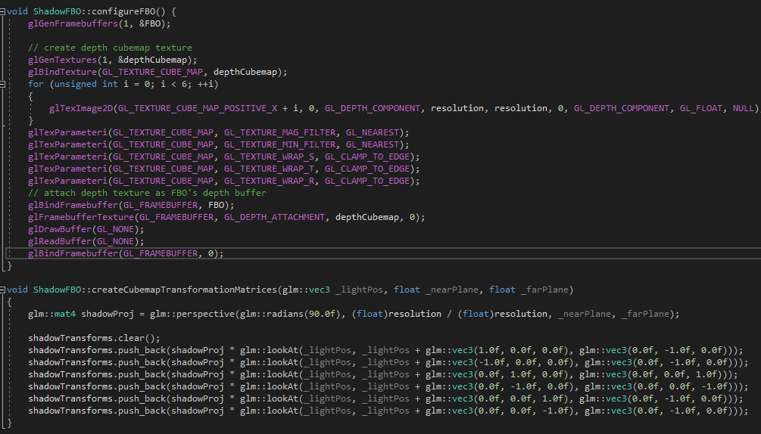
Design - Omnidirectional Shadow Map using point lights
Generally implemented using directional light and single depthmap.
Create 6 depth maps to create a depth cubemap.
Store in frame buffer.
Render the scene once into depth cubemap.
Use cubemap to render the scene again but with shadows

Slide 15
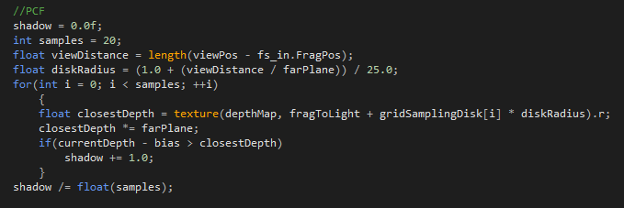
Design - Percentage Closer Filtering
Implement soft shadows to help remove jagged edges.
PCF helps smooth out shadows

Slide 16
Shadow Demo Results

Slide 17
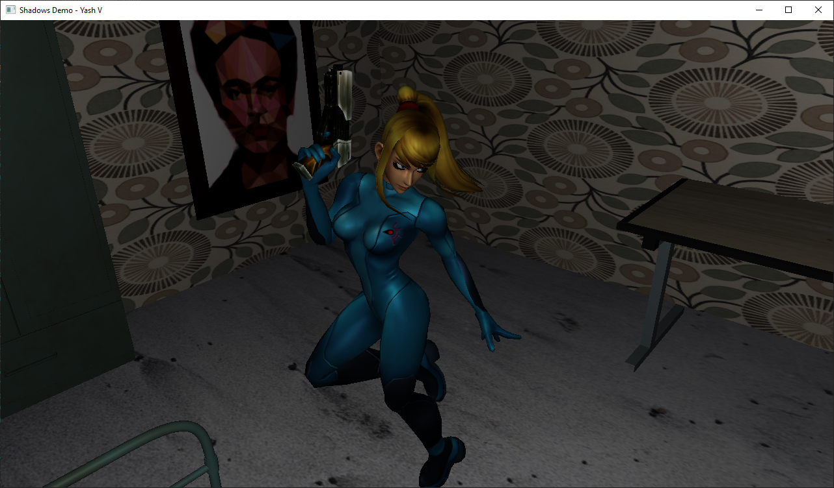
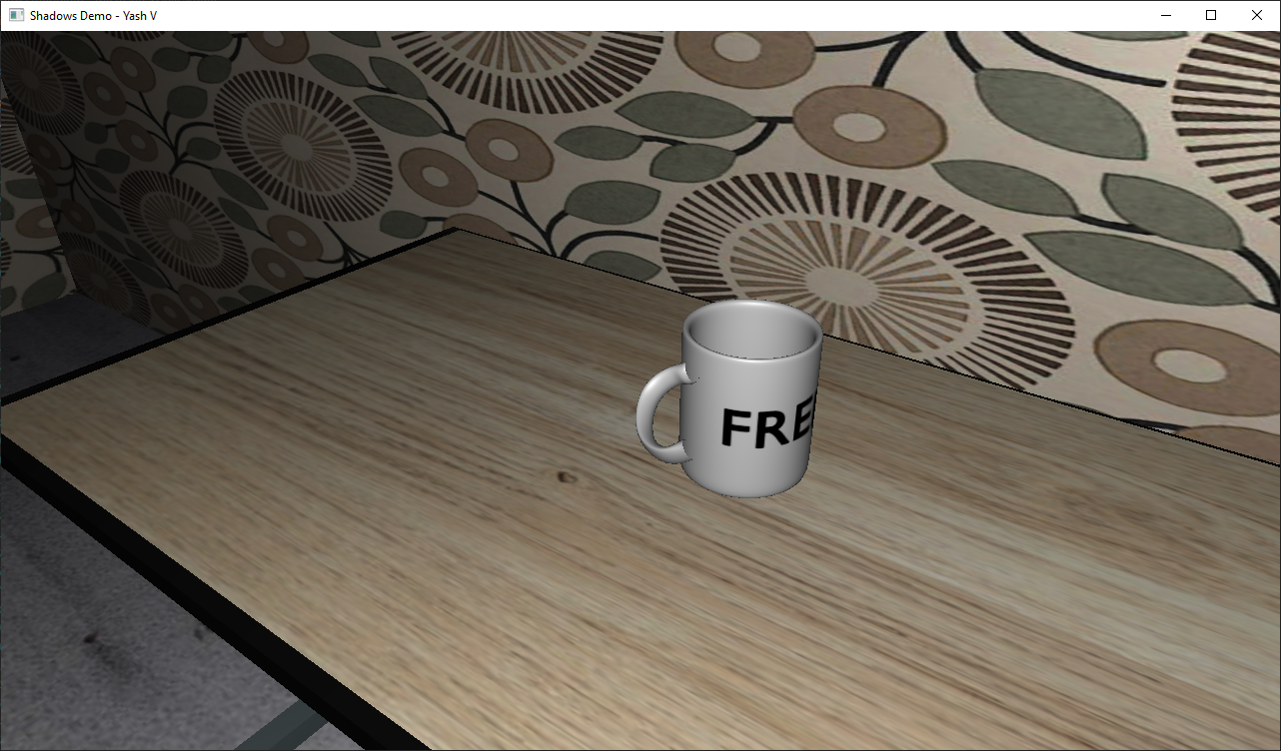
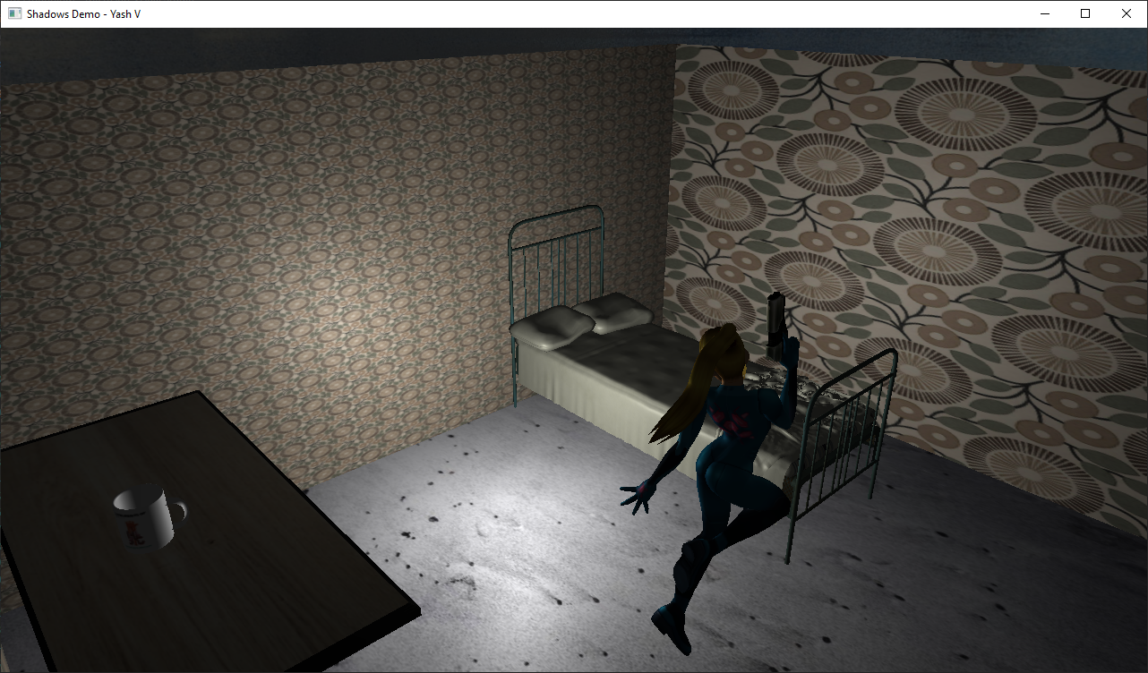
Qualitative results - 1
No Shadows

Slide 18
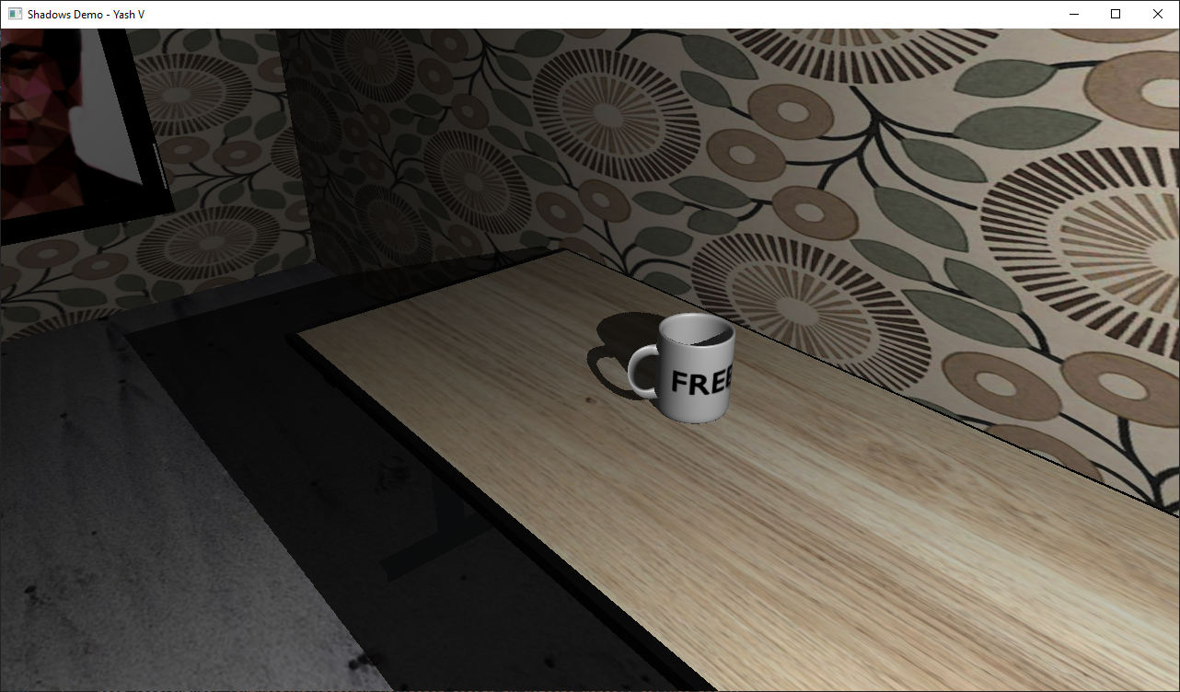
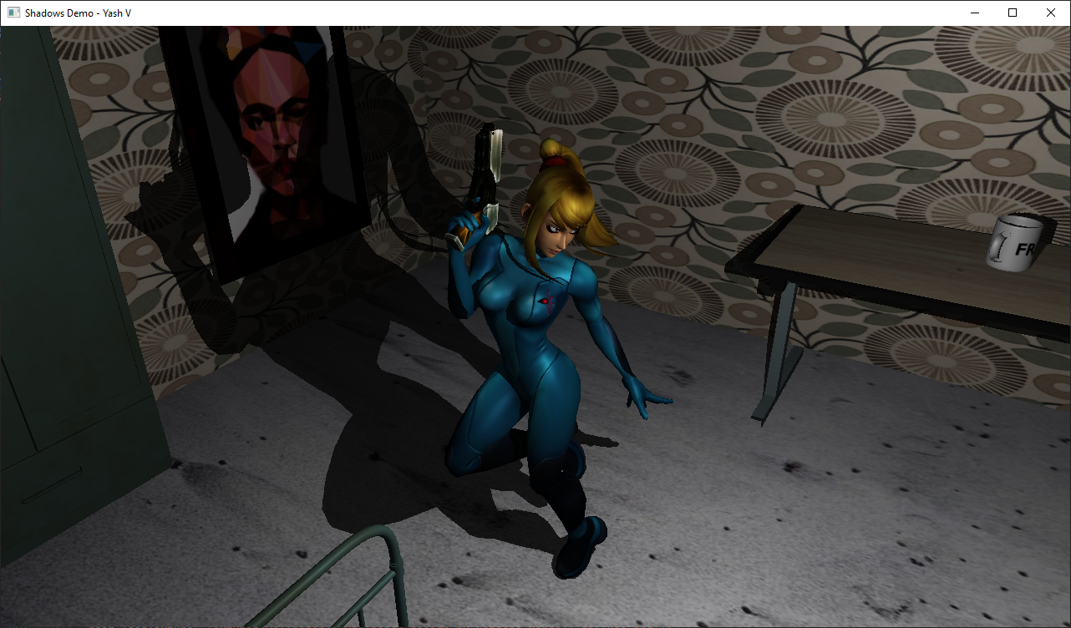
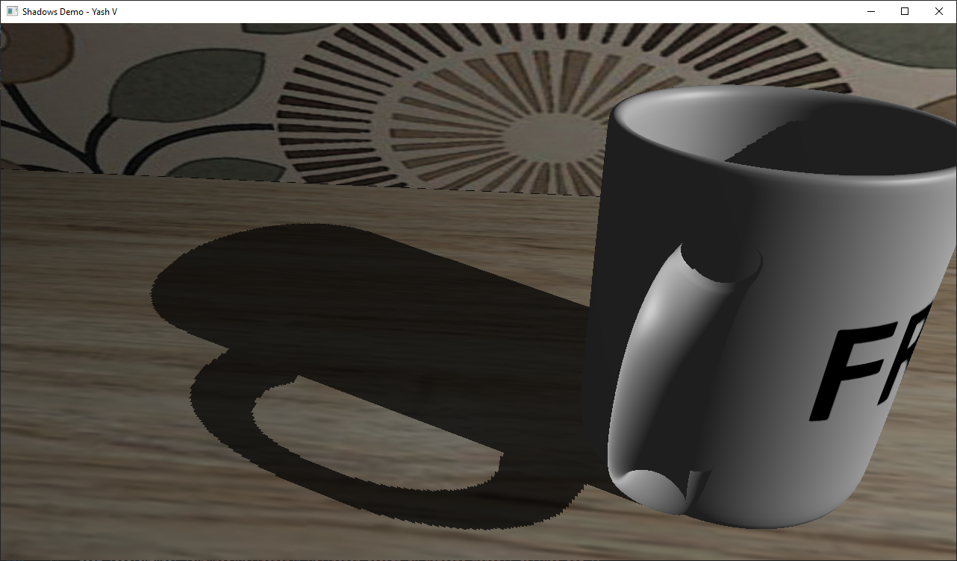
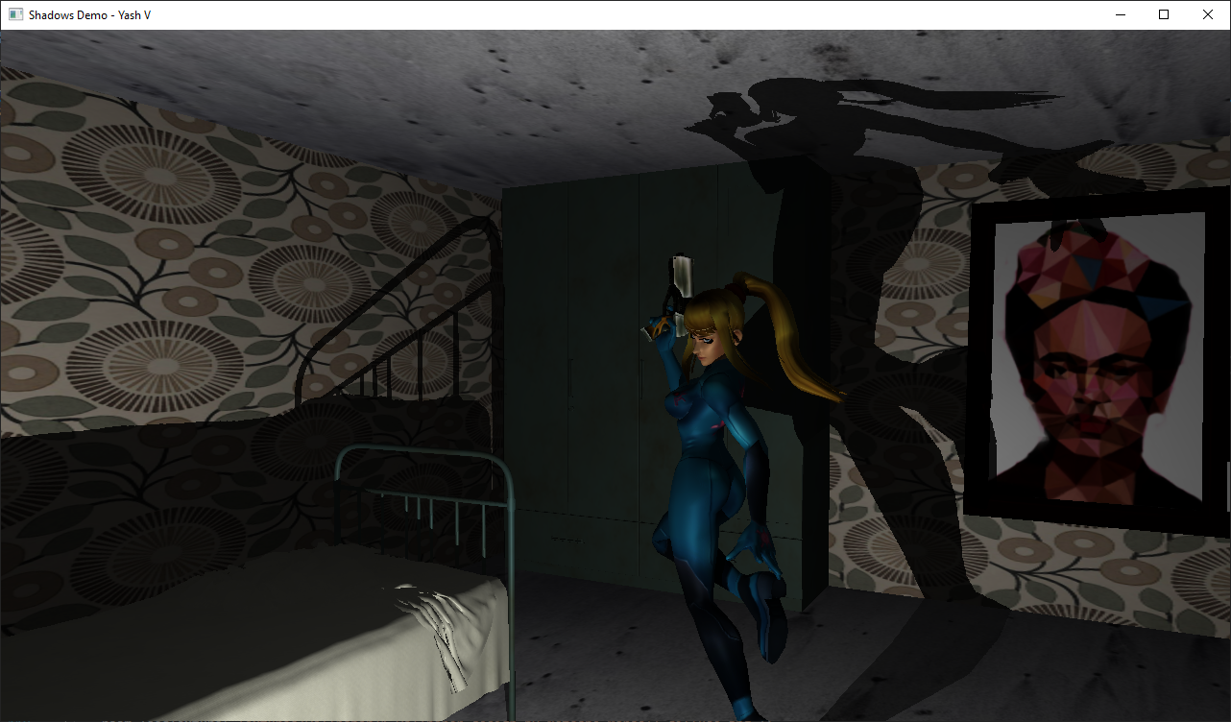
Qualitative results - 2
Omnidirectional Shadow Mapping
(No PCF)

Slide 19
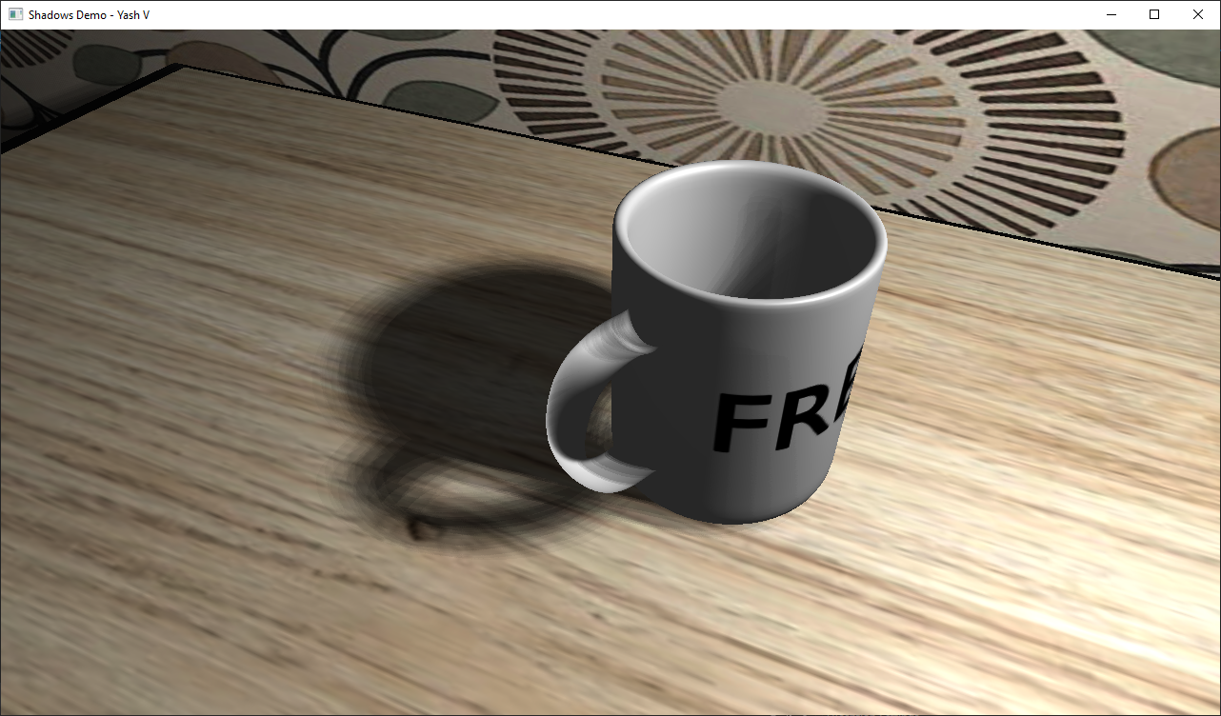
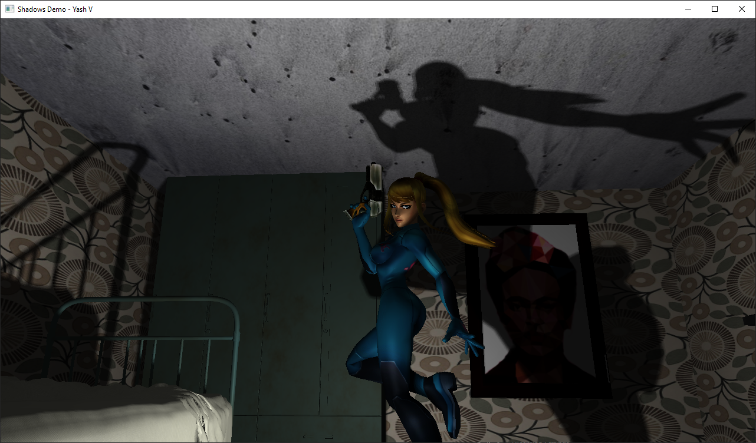
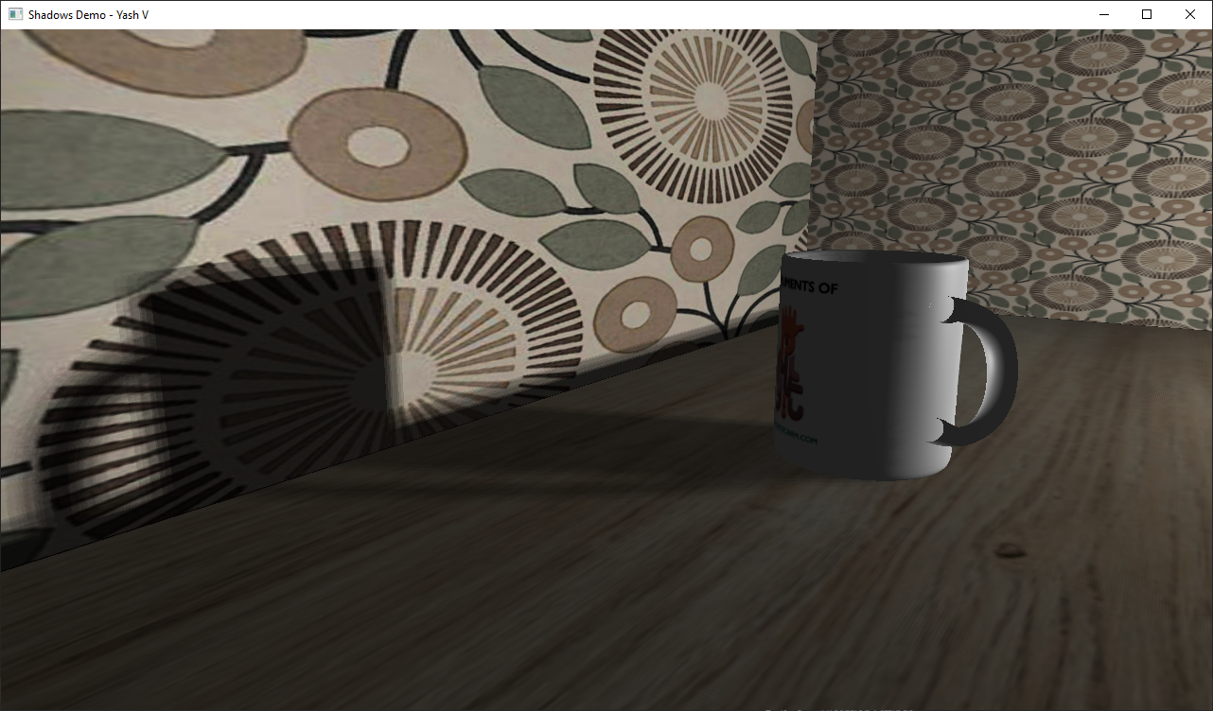
Qualitative results - 3
PCF

Slide 20
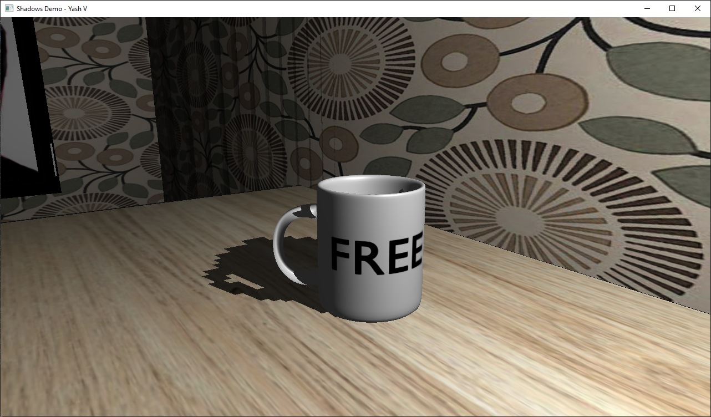
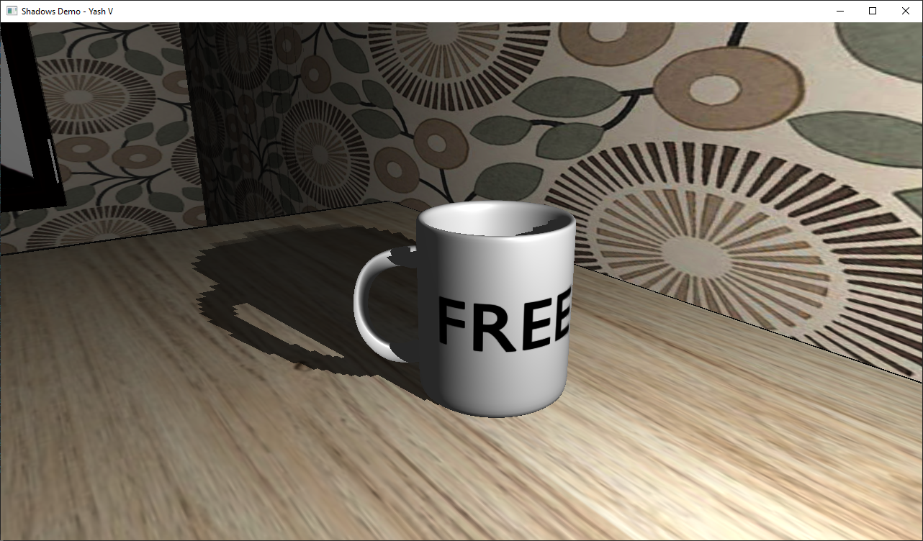
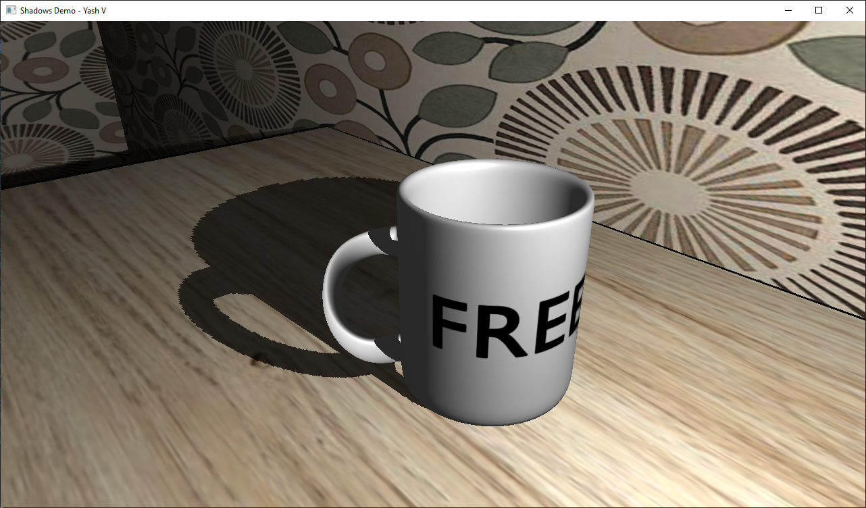
Quantitative results - 1
Resolution (pixels) | Load Time (seconds)
104 | 12.2087
208 | 12.1268
512 | 12.2157
104
208
512

Slide 21
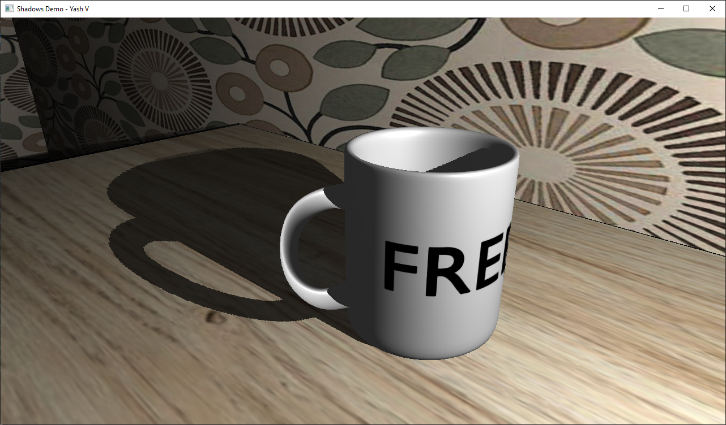
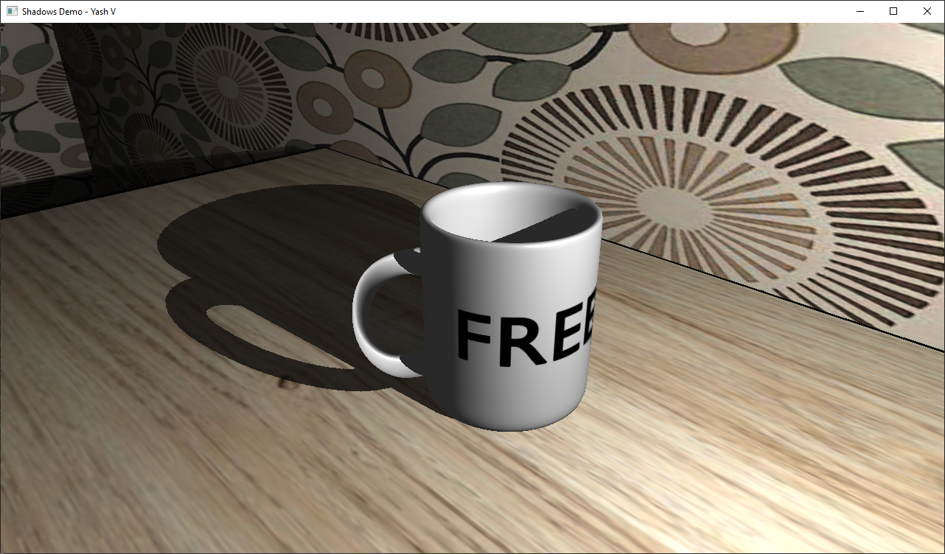
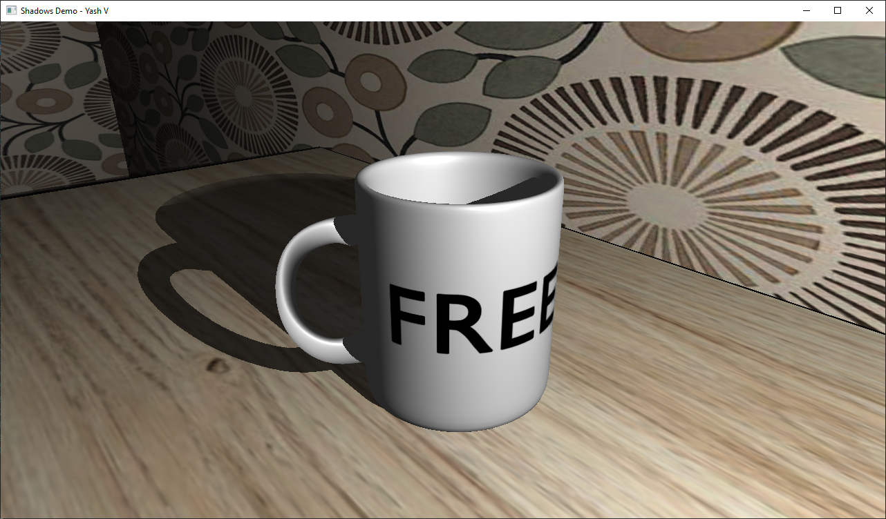
Quantitative results - 2
Resolution (pixels) | Load Time (seconds)
1024 | 12.1629
2048 | 12.1761
4096 | 12.1904
1024
2048
4096

Slide 22
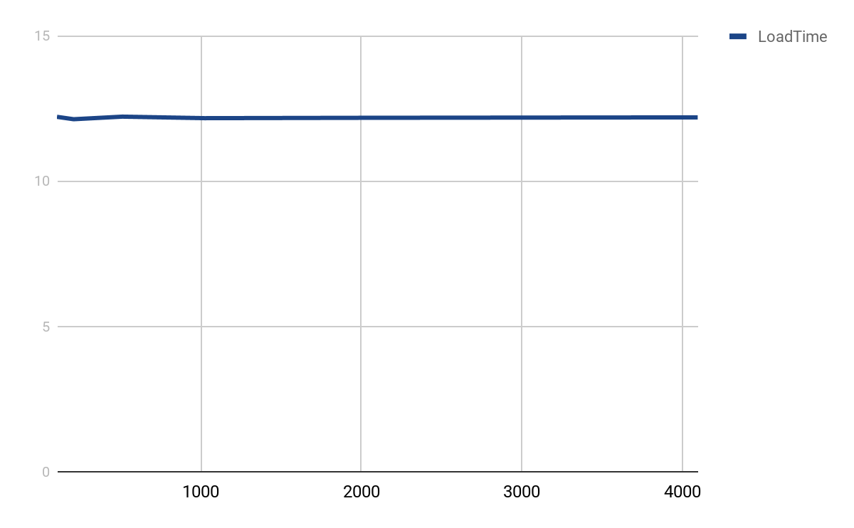
Quantitative results - 3
No obvious trend
Mean load time:
12.1801‬s

Slide 23
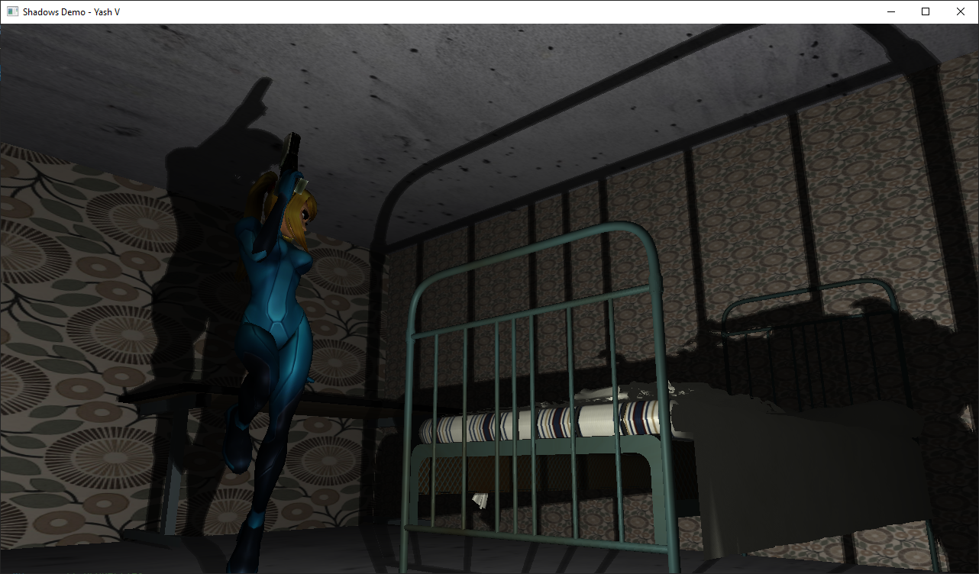
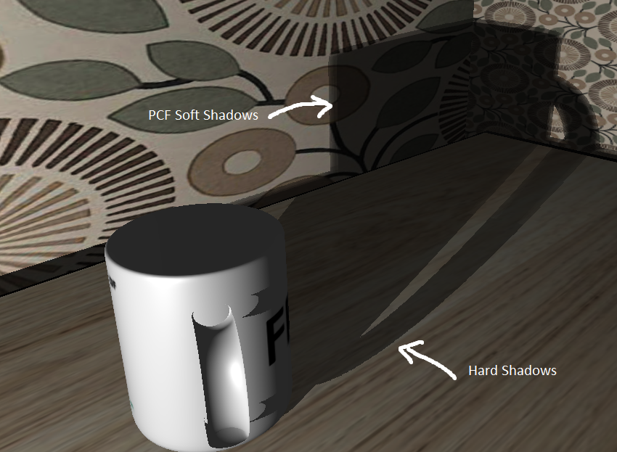
Qualitative results - 4
PCF (altered to check depth before calculating)

Slide 24
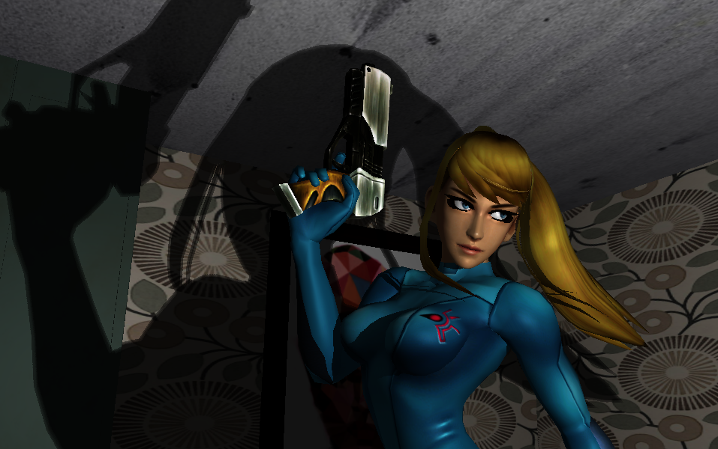
Evaluation
Pretty happy with results
Implement multiple lights then test performance
Have PCF sample size increase linearly with the distance of fragment to light. Smoother hard shadows to PCF transition

Slide 25
References
Variance Shadows
https://developer.nvidia.com/gpugems/gpugems3/part-ii-light-and-shadows/chapter-8-summed-area-variance-shadow-maps
Deep shadow maps
http://www-graphics.stanford.edu/papers/deepshadows/
Stencil shadow volume
http://ogldev.atspace.co.uk/www/tutorial40/tutorial40.html
Umbra
https://www.timeanddate.com/eclipse/umbra-shadow.html
Science of light and shadows
https://scienceinprek.si.edu/science-light-and-shadows
Shadows
https://www.cyberphysics.co.uk/topics/light/shadow/shadow.htm
Formation of Shadows
https://www.youtube.com/watch?v=SvSHx3XWRik
Modern OpenGL Tutorials
http://ogldev.atspace.co.uk/www/tutorial43/tutorial43.html
LearnOpenGL
https://learnopengl.com/

